Slide 1
TPS65992BG GUI TOOL
PPS Specific and General Overview

Slide 2
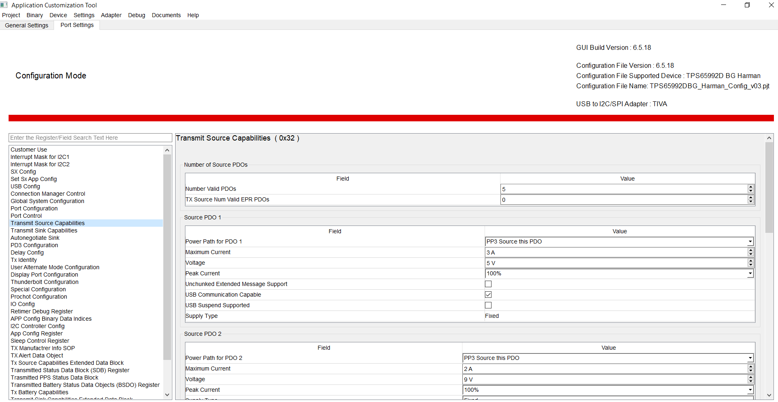
General GUI Overview

Slide 3
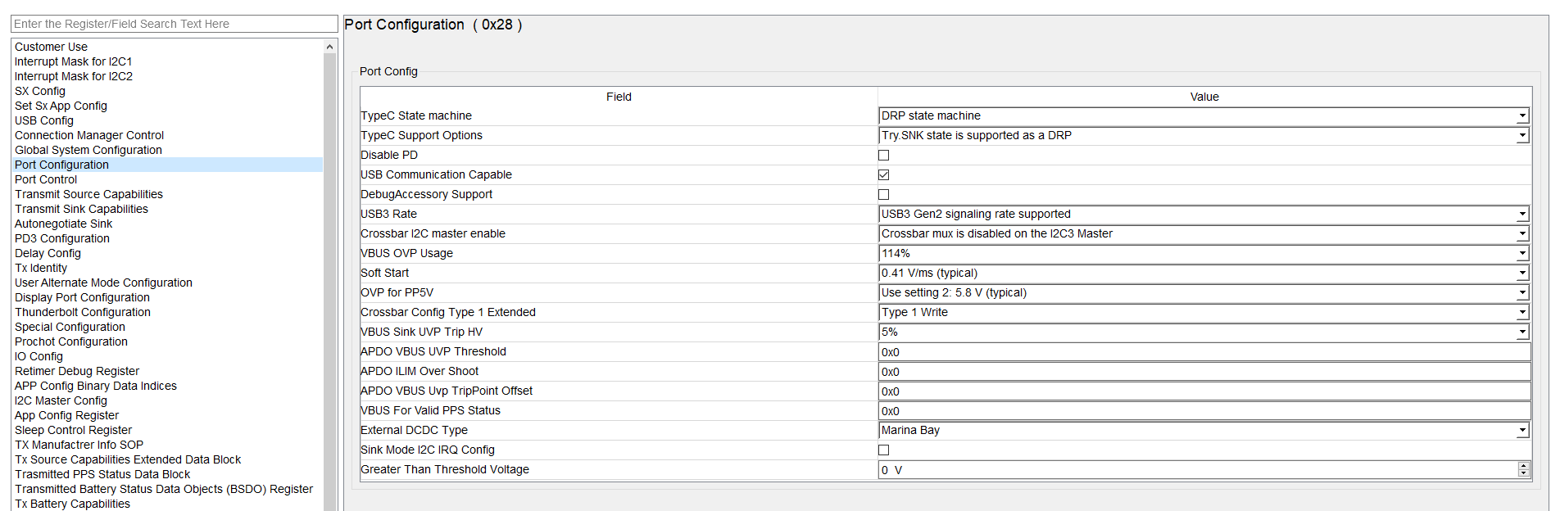
Port Configuration
Preferred sink power role with DRP state machine. Therefore, PD will request to be a sink for most connections, will still be able to source for Samsung phones.

Slide 4
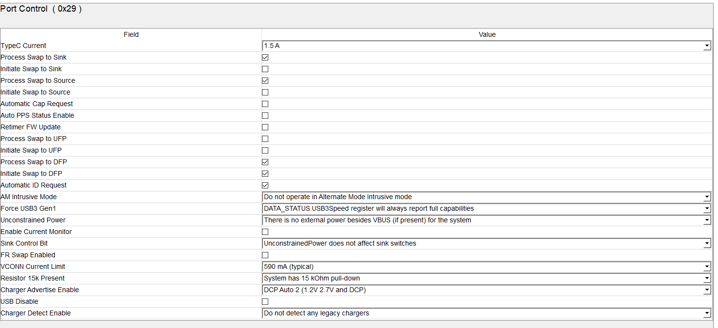
Port Control
DCP Auto 2 (1.2V and 2.7V) are Apple and Samsung charging indicators for legacy devices on D+/D-.

Slide 5
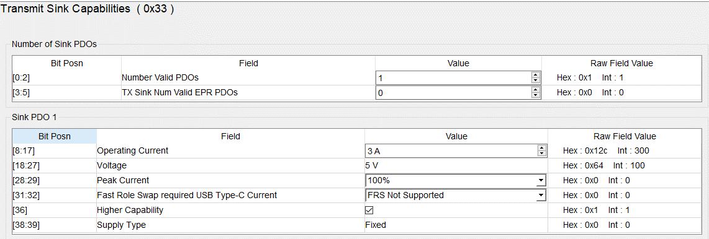
Transmit Sink Capabilities
Sink PDOs can be configured in Transmit Sink Capabilities register.

Slide 6
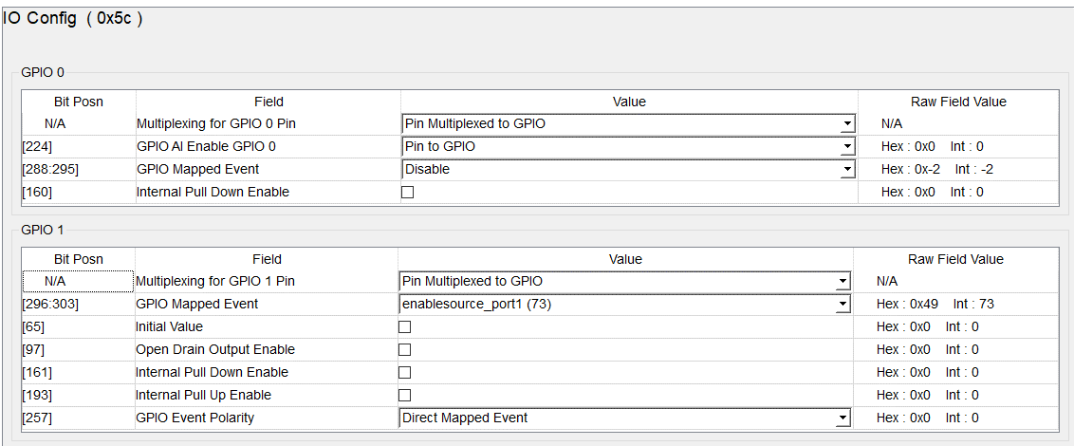
IO Config
GPIOs are mapped and configured in IO config.
You can use the mapped event from TRM to configure GPIO.

Slide 7
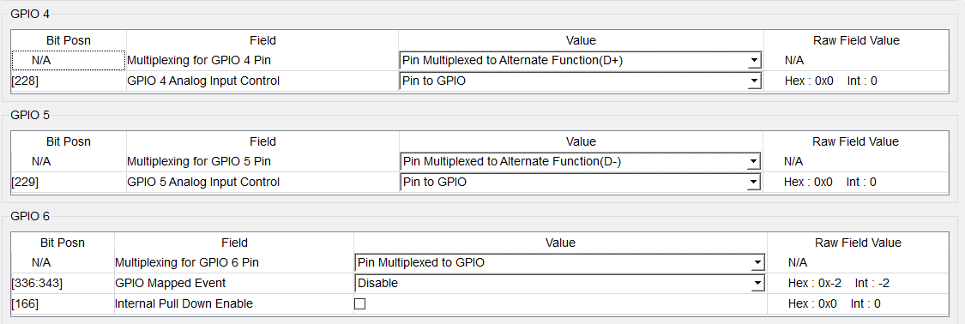
IO Config Continued
GPIO 4 and 5 are used for D+ and D- (other GPIOs not capable of D+/D-)

Slide 8
IO Config Continued
GPIO 4 and 5 are used for D+ and D- (other GPIOs not capable of D+/D-)

Slide 9
PPS Specific GUI Overview

Slide 10
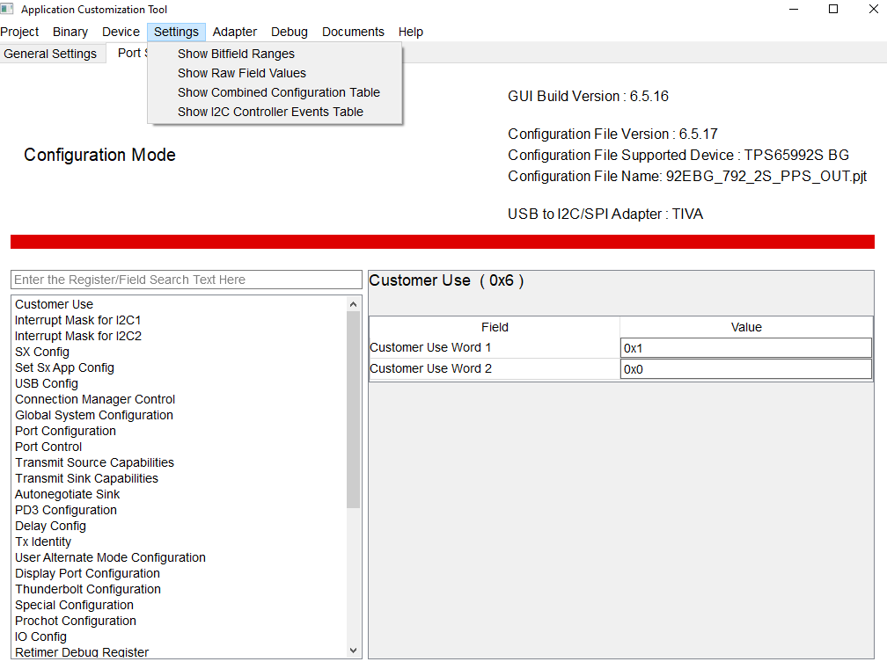
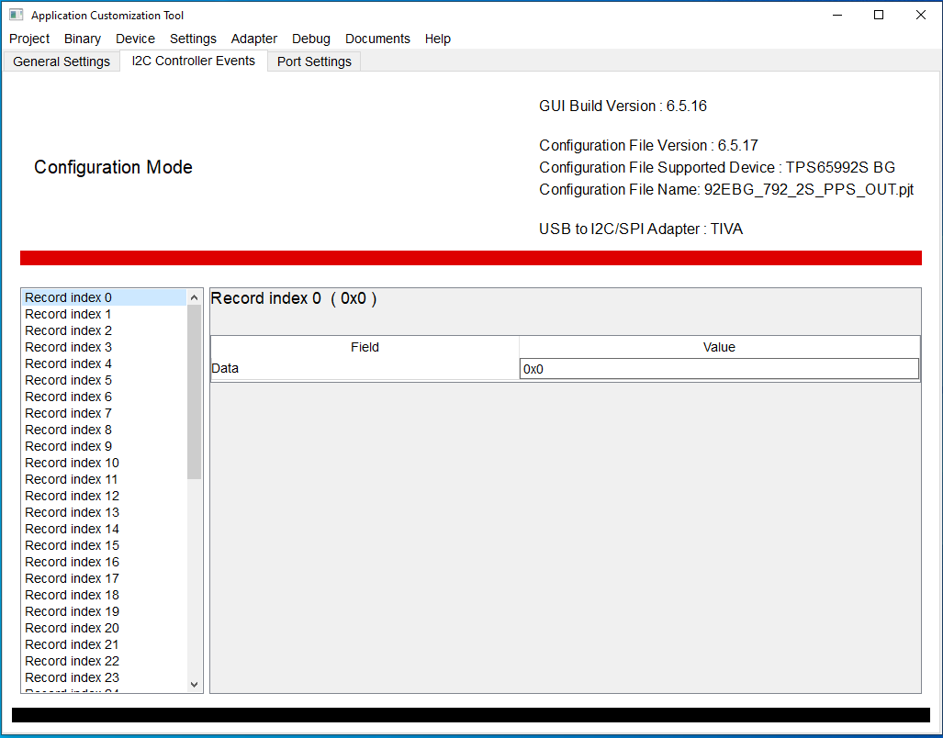
Access I2C Controller Events Table
To access the I2C Controller Events Table:
Record index 0 always empty

Slide 11
I2C Controller Events Table Purpose
To enable the PD controller to communicate with external devices, such as a battery charger, via I2C, when certain events are triggered by the PD controller.
Record index 0 is always empty

Slide 12
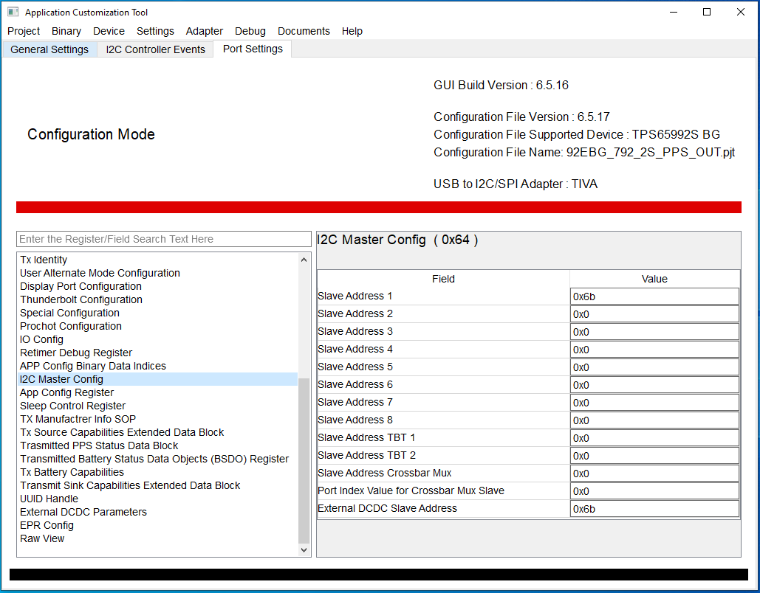
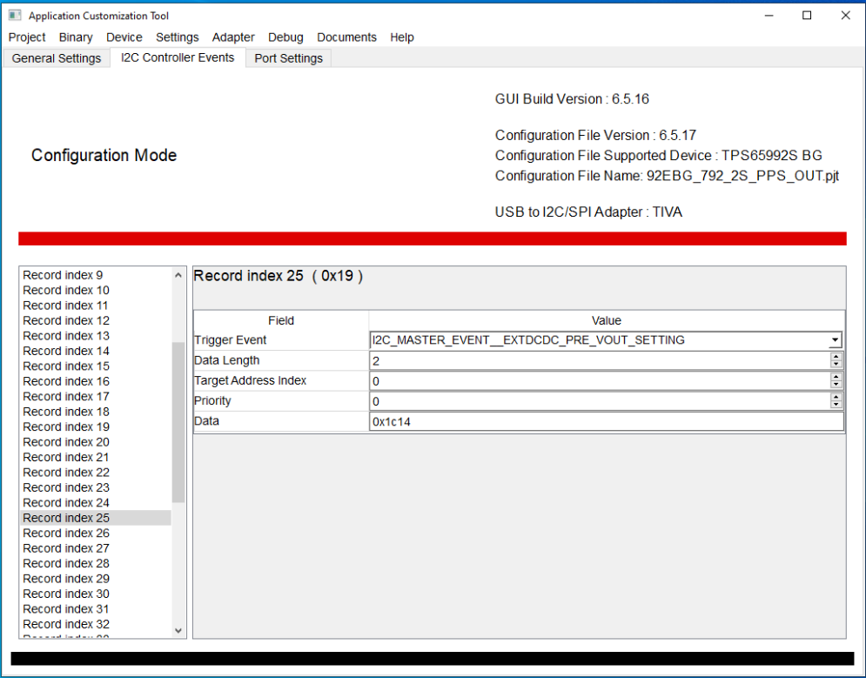
I2C Addressing – External DCDC
Trigger Events that begin with “I2C_MASTER_EVENT_EXTDCDC…” relate to the External DCDC Slave Address.
Target Address Index 0
…..................
Target Address Index 7

Slide 13
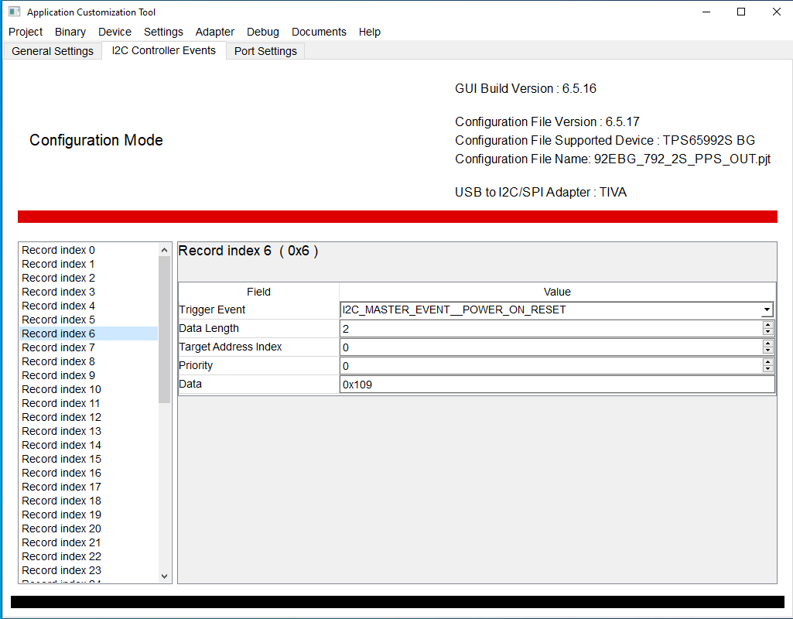
I2C Addressing
Slave Address [#] corresponds to the Target Address Index, when mapping I2C addresses.
Target Address Index 0
…..................
Target Address Index 7

Slide 14
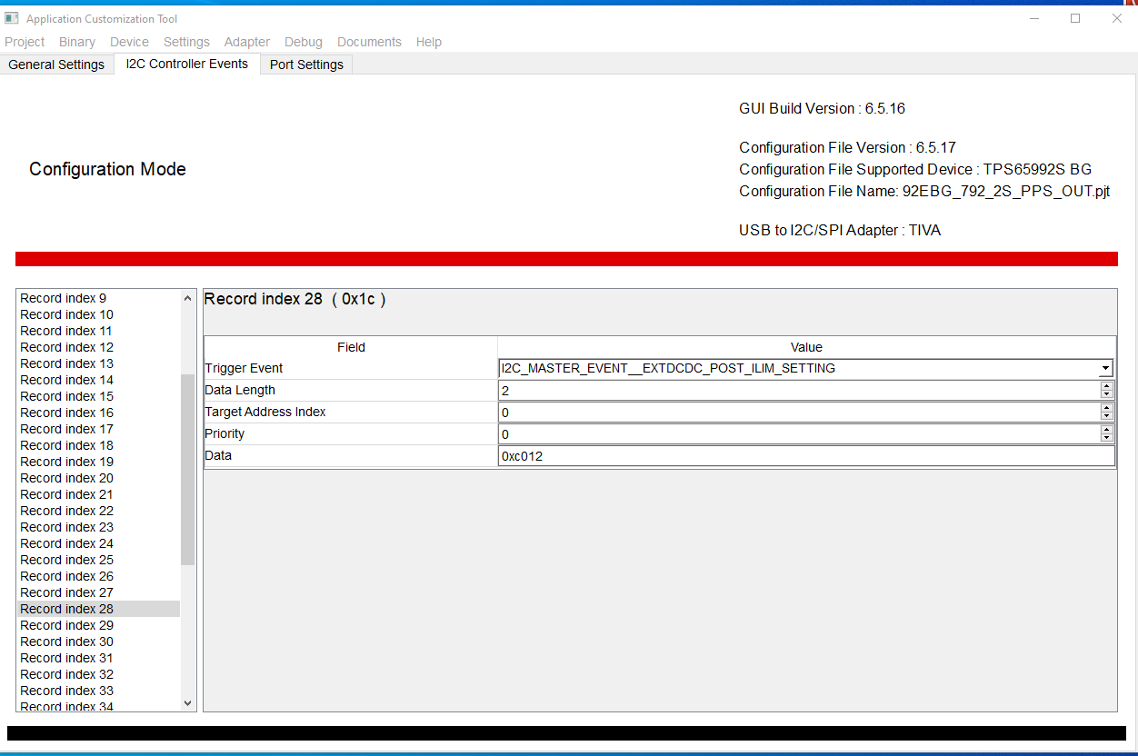
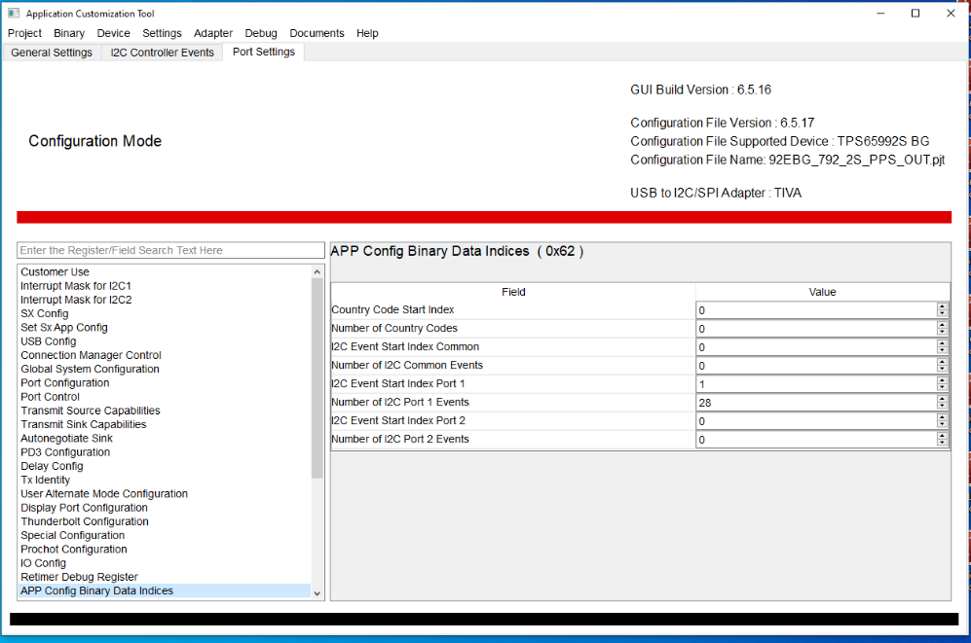
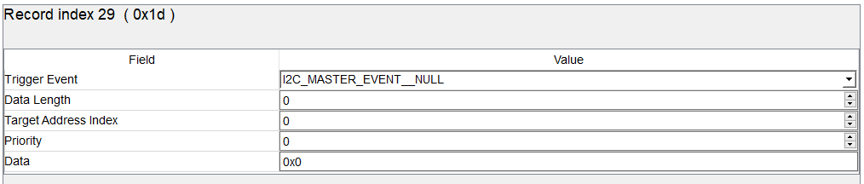
I2C Events Configuration

Slide 15
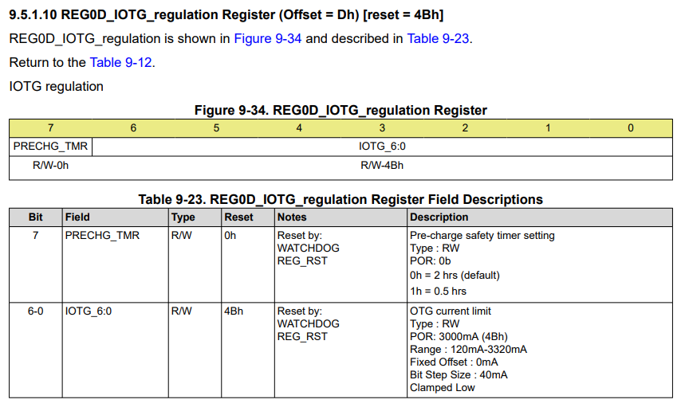
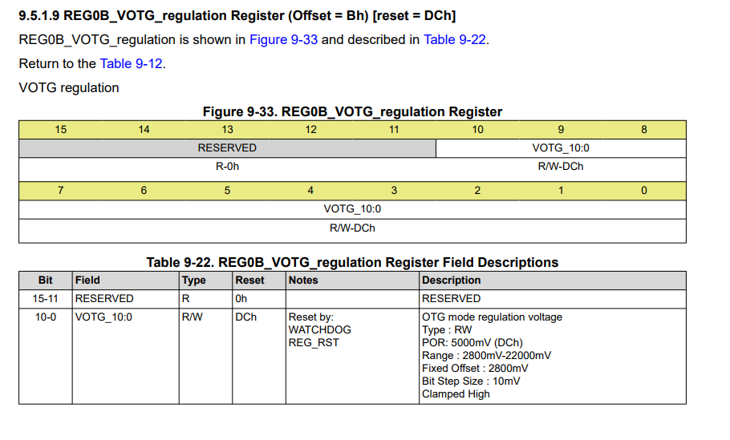
BQ25792 Registers for Configuring DCDC
These registers are referenced in the subsequent slides (slides 16 – 24) to provide an example of how to configure an external DCDC with this PD controller.

Slide 16
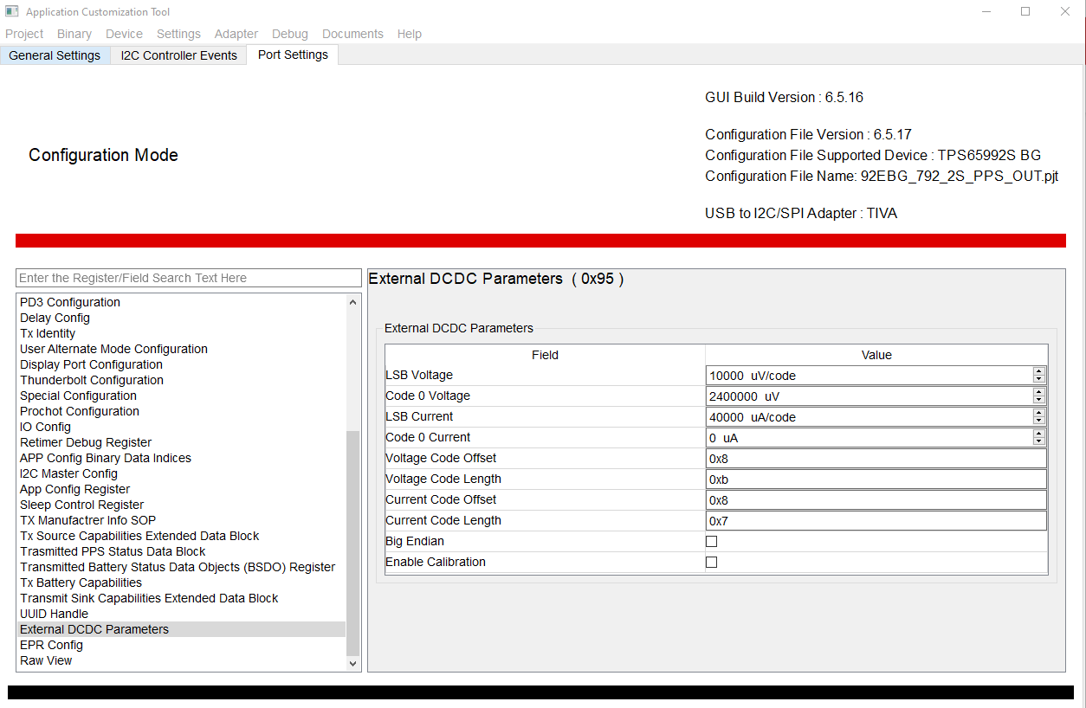
External DCDC Parameters
LSB Voltage (uV/Code): Enter the step size for the voltage output in uV/code (Step).
Example: the output voltage for the BQ25792 is configured in register 0x0b. In Table 9-33/22 above, it is seen that the Bit Step size is 10mV, so 10000 uV/Code would be entered here.

Slide 17
External DCDC Parameters
Code 0 Voltage: This is the voltage (in uV) that will be output if a code value of 0 is set.
Example: for the BQ25792, the minimum output voltage is 2.8V, (as listed in Table 9-22 above), as shown by the “Range” field of Table 9-33. Therefore, a code ‘0’ will result in 2.8V output. We have reduced our code ‘0’ voltage to 2400000uV to account for ~400mV drop in cable loss for demo purposes.

Slide 18
External DCDC Parameters
LSB Current (uA/Code): Enter the step size for the current limit in uA/Code.
Example: the current limit for the BQ25792 is configured in register 0x0d. In Table 9-34/23, it is seen that the Bit Step size is 40mA, so 40000 uA/Code would be entered here.

Slide 19
External DCDC Parameters
Code 0 Current: This is the current in uA that will be output if a code value of 0 is set.
Example: for the BQ25792, the fixed offset current is 0mA, therefore there is no need to set a current code 0.

Slide 20
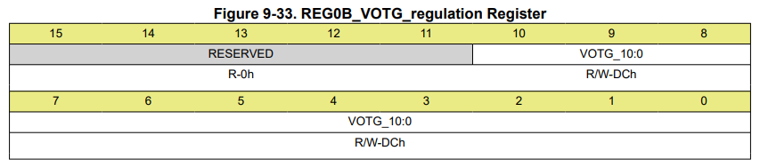
External DCDC Parameters
Voltage Code Offset: This field represents where in the I2C command the actual voltage code value would reside.
Example: As mentioned above, the code value for output voltage setting resides in register 0x0b. If you refer to that register, you will note the least significant bit is used in VOTG setting, so the value is not offset by any amount. By reviewing the BQ25792 datasheet further you will notice that the I2C command to set the output voltage is sent with the register first (0x0b). The offset would be 8 bits (8 bits for the register address) + the 0 bits for the offset within register 0x0b. The user would enter a value of 0x8 for the Voltage Code Offset.

Slide 21
External DCDC Parameters
Voltage Code Length: This field represents the number of bits that are used for the voltage output of the external DCDC converter.
Example: Referring to register 0x0b for the BQ25792 datasheet, you will notice that the VOTG goes from bit 0 through bit 10, which is 11 total bits to represent the output voltage. The user would enter a value of 0xb for the Voltage Code Length.

Slide 22
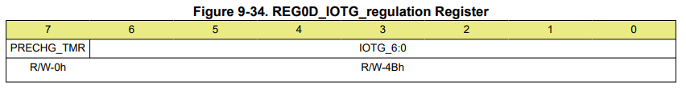
External DCDC Parameters
Current Code Offset: This field represents where in the I2C command the actual current limit code value would reside.
Example: As mentioned above, the code value for the current limit setting resides in register 0x0d. If you refer to that register, you will note the least significant bit is used in IOTG setting, so the value is not offset by any amount. By reviewing the BQ25792 datasheet further you will notice that the I2C command to set the current limit is sent with the register first (0x0d). The offset would be 8 bits (8 bits for the register address) + the 0 bits for the offset within register 0x0d. The user would enter a value of 0x8 for the Current Code Offset.

Slide 23
External DCDC Parameters
Current Code Length: This field represents the number of bits that are used for the current limit of the external DCDC converter.
Example: Referring to register 0x0d for the BQ25792 datasheet, you will notice that the IOTG goes from bit 0 through bit 6, which is 7 total bits to represent the current limit. The user would enter a value of 0x7 for the Current Code Length.

Slide 24
External DCDC Parameters
Big Endian: This box gets set if the registers are represented as big endian within the external DCDC converter.
Example: The I2C interface description within the BQ25792 datasheet states that the registers are defined as Little Endian, so this box would not get selected for the BQ25792.

Slide 25
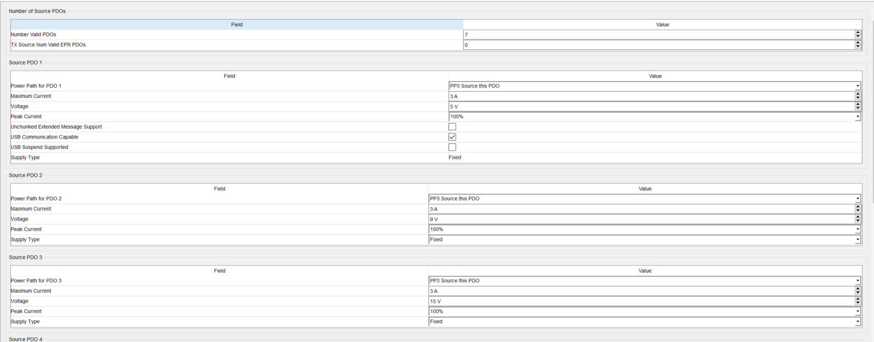
Transmit Source Capabilities: PDOs 1-3
PDO 1 must be a 5 V contract.
PDOs 2-7 can be whatever you want (fixed PDO or APDO).

Slide 26
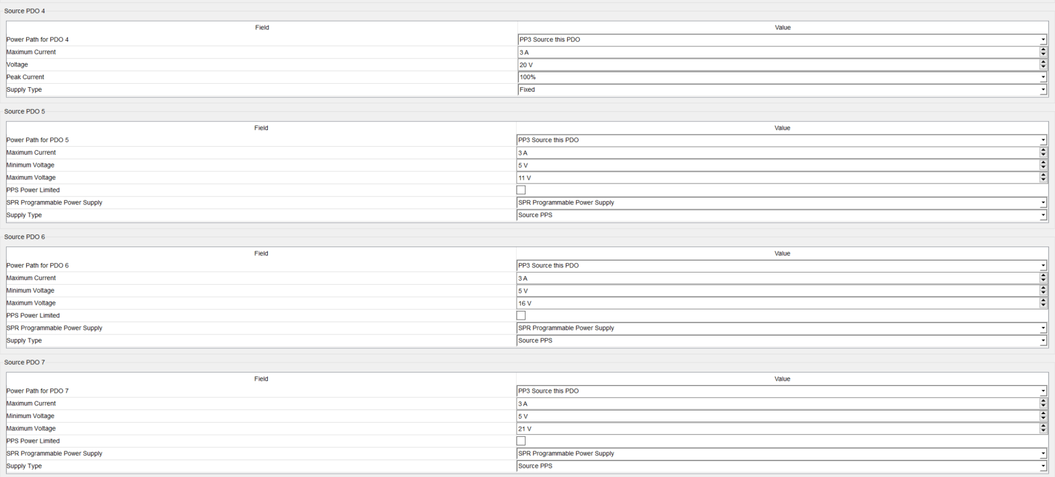
Transmit Source Capabilities: PDOs 4-7
PDOs 1-4 are currently fixed contracts.
PDOs 5-7 are currently PPS (APDO) contracts.

